Slide 1


University of Maine
14 September 2016
Data wrangling, visualization, and modelling in r and rstudio
Trevor Avery, Ph.D., P.Stat.
Professor, Acadia University
Danielle Quinn
PhD Candidate, Memorial University

Slide 2
R is taking over science!
Pros
Free and Open Source
OS independent
HUGE user base
Excellent and consistent documentation (format etc.)
Modular (via “packages”)
Many previous projects are moving to R
Q (Legendre), ADE, etc.
Very powerful
Cons
Initially a steep learning curve
Mainly non-GUI (graphical user interface)
Rcmdr, JAGR, RStudio

Slide 3
What Can R do?
Manipulating / Summarizing Data
Statistics / Modelling
Visualizations
… so much more!

Slide 4
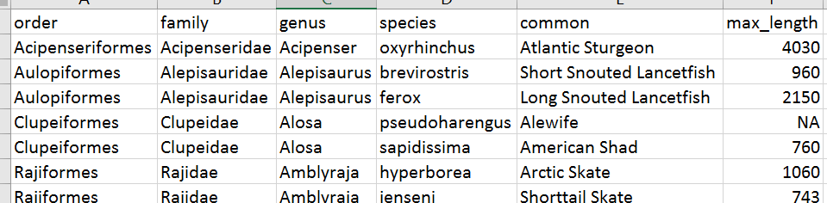
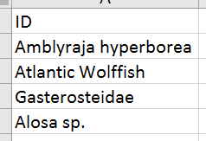
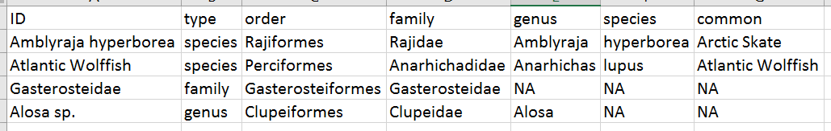
What Can R do?
Data Management / Cleaning
Reference Table
Data
Data
Notes:
Update as data changes
Report generating

Slide 5
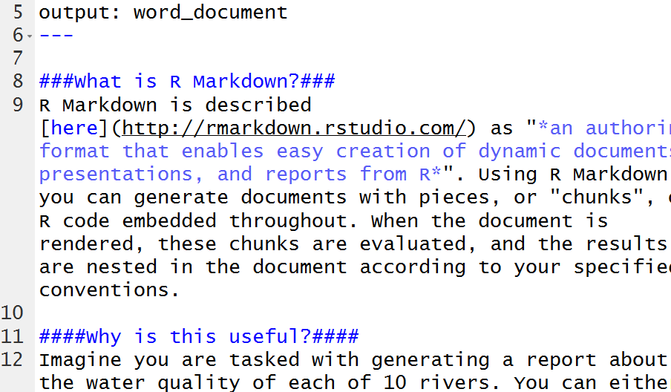
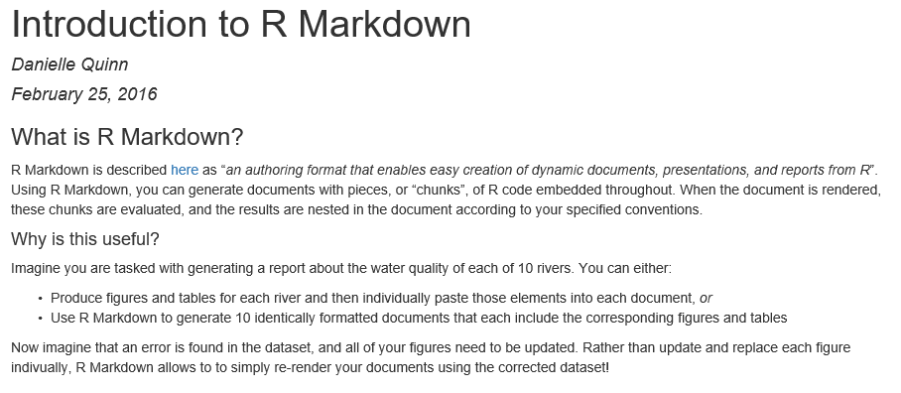
What Can R do?
Dynamic Documents (R Markdown)
Notes:
Update as data changes
Report generating

Slide 6
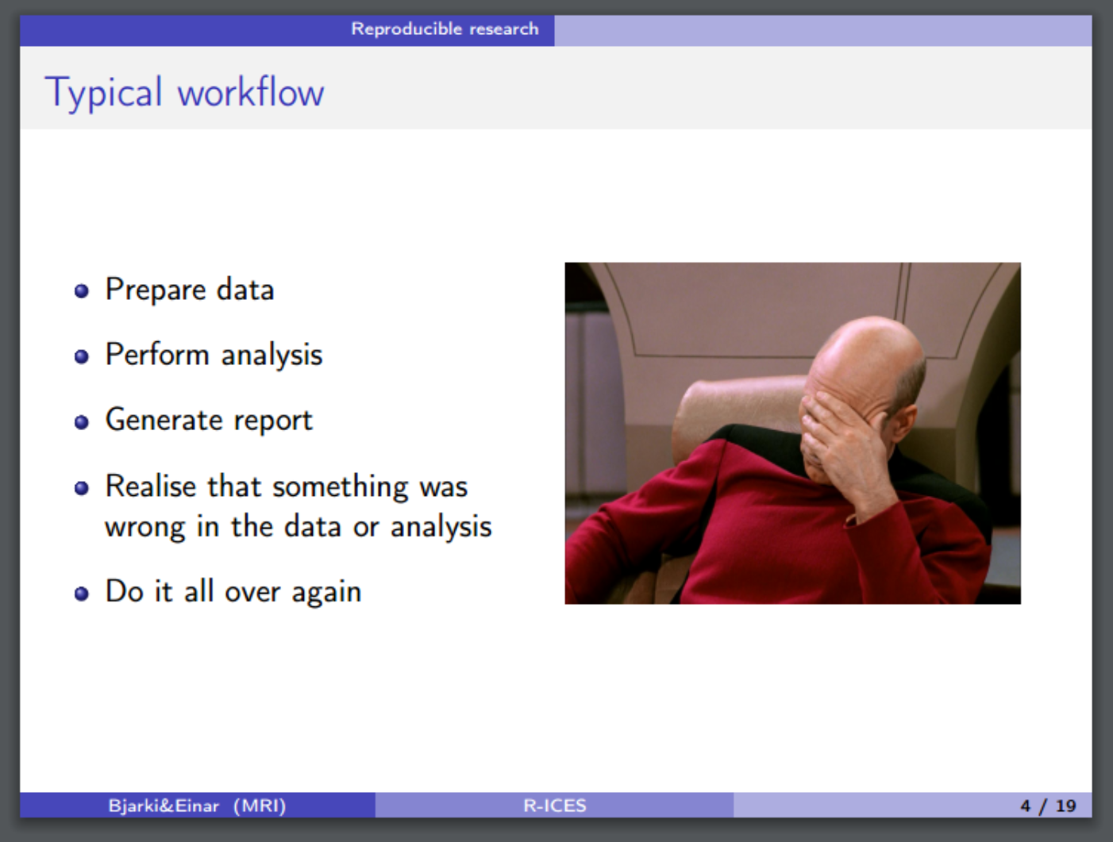
What Can R do?
Dynamic Documents (R Markdown)
Notes:
Update as data changes
Report generating

Slide 7
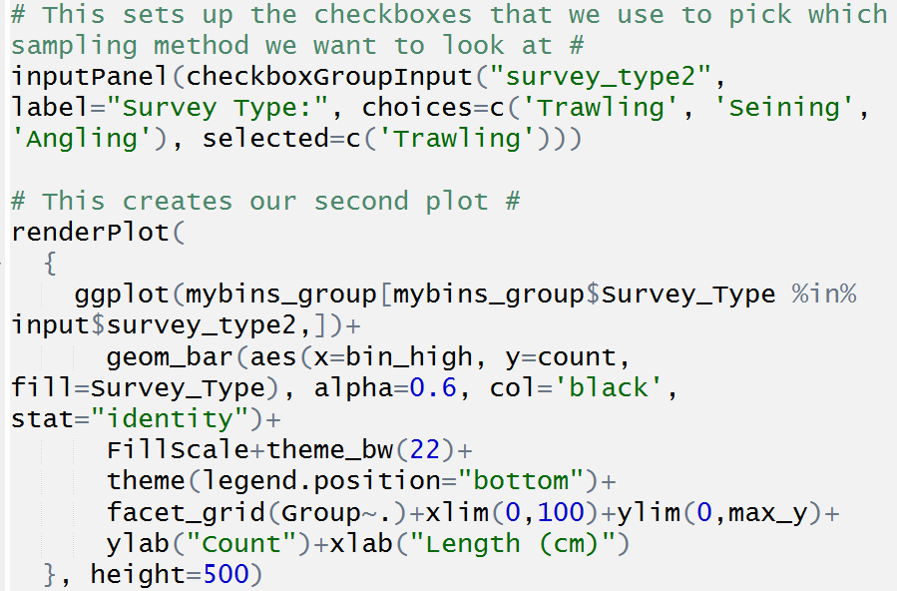
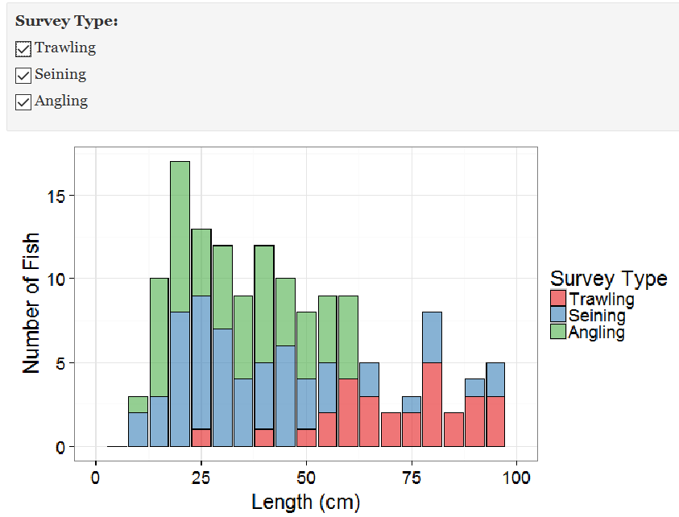
What Can R do?
Web Based Apps (R Shiny)
Notes:
Interactive
Web Based or Local
Data Exploration
Information Gathering
Public Access
Can link to DropBox using an authenticator
Can password protect

Slide 8
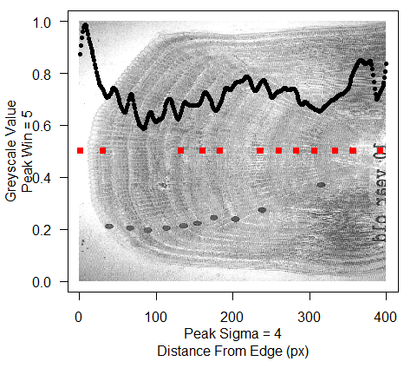
What Can R do?
Image Analysis

Slide 9
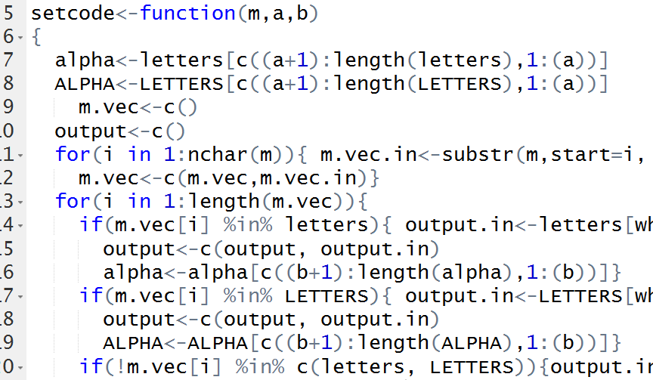
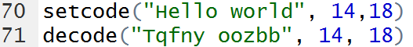
What Can R do?
Image Analysis
Cryptography

Slide 10
Resources https://github.com/DanielleQuinn/MaineCourse
This presentation
Code along .R scripts (x4)
Demonstrations & associated data (modified from Zuur)
Linear Models to Generalized Linear Models
Mixed Effect Models
Zero Inflated Models
Online Tutorials
http://daniellequinn.github.io/RLessons/
Shared note space
https://public.etherpad-mozilla.org/p/Maine_RCourse_14Sept16
R Reference Card
https://cran.r-project.org/doc/contrib/Short-refcard.pdf
Cookbook for R
http://www.cookbook-r.com/

Slide 11
Workshop outline
Module 1: Introduction to R
Getting Started with R and RStudio
R Basics
Importing Data
Module 2: Exploring and Visualizing Data
Formatting Dates Using {lubridate}
Summarizing Data Using {dplyr}
Visualizations Using {ggplot2}
Module 3: LMs to GLMs
Linear Models (LMs)
General Linear Models (GLMs)
Diagnostics and Model Selection

Slide 12
Workshop outline
Module 1: Introduction to R
Getting Started with R and RStudio
R Basics
Importing Data
Module 2: Exploring and Visualizing Data
Formatting Dates Using {lubridate}
Summarizing Data Using {dplyr}
Visualizations Using {ggplot2}
Module 3: LMs to GLMs
Linear Models (LMs)
General Linear Models (GLMs)
Diagnostics and Model Selection
coffee
lunch
coffee
Notes:
9:00 Introduction (who are we, what is R, what can R do) – 10 minutes
9:10 Install R and RStudio – 5 minutes
9:15 R Basics – 75 minutes (use codealong1.R)
10:30 Coffee
10:45 Script Clarity, Importing Data, QAQC, Indexing Data Frames – 1 hour (create own R script)
11:45 Formatting Dates – 10 minutes
12:00 Lunch
1:00 Summarizing and Visualizing Data – 45 minutes (use codealong1.R)
1:45 Hands-On – 30 minutes (own script)
2:15 Basic Statistical Tests, Linear Models – 30 minutes (use codealong2.R)
2:45 Coffee
3:00 GLMMS and Zero Inflated, Diagnostics – 90 minutes (use codealong2.R)
4:30 Wrap Up, Discussion, Questions, Resources

Slide 13
Module 1: Introduction to R
RStudio (never use RGui / command line again…)
Learning a new language – “R”
Basic vocabulary
Core concepts
Indexing
It’s all about script clarity!
How to stay organized
# Commenting your code
# ---- Creating Sections ----
I lied. It’s also about data quality.
Spreadsheet formatting & exporting data
Importing data & QAQC
Best practices (trust us!)
Notes:
32 slides (24 unique) + 4 exercises

Slide 14
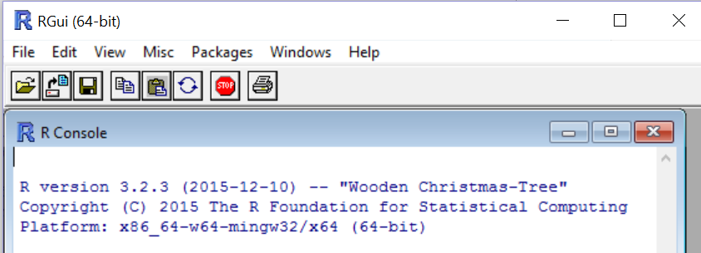

Exercise 1.1
(A) Install R
http://cran.r-project.org/bin/windows/base/
(B) Install RStudio
http://www.rstudio.com
(C) Open Maine_CodeAlong1.R
Notes:
RStudio: Not a point and click type of GUI, no drop down menus, etc.
Timing: until everyone is ready (aim for <10 min)

Slide 15
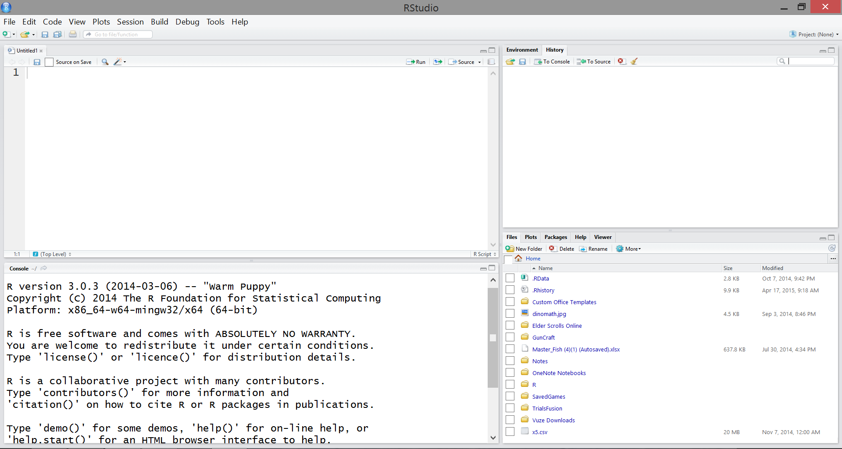
Our first look at rstudio

Slide 16
Our first look at rstudio
Environment
current objects, data, etc.
Source
saved script file used for ongoing projects and analyses
History
recently run code
Plots
Help
Console
(1) output & (2) used for on-the-fly coding, not saved in script file
Packages
collections of functions available for use

Slide 17
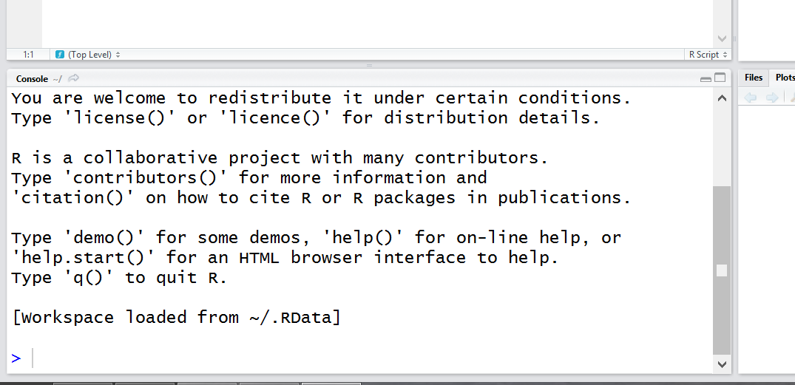
R basics: input and output
> ready
+ waiting
busy
> 5
[1] 5
> 1:10
[1] 1 2 3 4 5
[6] 6 7 8 9 [10] 10
Notes:
> 5
[1] 5
[1] shows position of value
> 1:10 # : means from one to ten
** actually do 1:100 to show positions
If it’s busy, don’t do anything.
If it’s waiting, either hit escape to cancel or figure out what it’s waiting for and do that. (We’ll see an example of this soon)

Slide 18
R basics: R is a calculator
+ addition
- subtraction
* multiplication
/ division
^ exponent
R follows order of operations
8 + 7 x 7 / (2 + 1) – 19
> 8+7*7/(2+1)-19
[1] 5.333333
Start Maine_CodeAlong1.R
Notes:
Do this in the console; note that this code isn’t “saved” anywhere, but is accessible via the History tab.

Slide 19
R basics: R is a calculator
+ addition
- subtraction
* multiplication
/ division
^ exponent
R follows order of operations
8 + 7 x 7 / (2 + 1) – 19
> 8+7*7/(2+1)-19
[1] 5.333333
What if I want to deal with more complex mathematical operations?
Notes:
Like a calculator, R can also deal with more complex math operations, like ln, log, and square root. R achieves this using functions. You can easily recognize a function because it has a function name followed by round brackets. Note that R isn’t always straightforward, using log() to find ln and log10() to find log.

Slide 20
R basics: functions
Functions are used to “do things” in R
function(argument)
Notes:
Here’s how functions work. They do things in R. This is how they are set up. Name, brackets, one or more arguments inside the brackets.

Slide 21
R basics: functions
Functions are used to “do things” in R
function(argument)
log() ln
log10() log
sqrt() square root
Notes:
R has specialized functions for standard mathematical functions.
Note: R isn’t always straightforward… uses log() to find ln and log10() to find log10!

Slide 22
R basics: functions
Functions are used to “do things” in R
function(argument)
> sqrt(81) # This finds the square root of 81
[1] 9
Notes:
For example, here we see the function called sqrt. By putting a value inside the round brackets, as an argument, we are telling R to give us the square root of the argument, here 81 gives us 9.

Slide 23
R basics: functions
Functions are used to “do things” in R
function(argument)
> sqrt(81) # This finds the square root of 81
[1] 9
Functions usually only accept specific types of arguments
> sqrt(“a”)
Error in sqrt(“a”): Non-numeric argument to mathematical function.
Notes:
Of course, in this particular function, only numeric values will work – if you tried to find the square root of “a”, R gives you an error report. We’ll go over some of the different types later.

Slide 24
R basics: functions
Functions can be nested
> sqrt(sqrt(81))
[1] 3
Notes:
You can also use functions inside of functions, layering and arranging them however you need!
Make sure that for each function, you have the appropriate open and close brackets. ( )

Slide 25
R basics: functions
Functions can be nested
> sqrt(sqrt(81))
[1] 3
Most functions have multiple arguments that use default values unless otherwise specified
You can build your own functions!
R Reference Card
Notes:
Multiple arguments: we’ll se more of this as we move on.
- not going to learn how to build functions today, as its rather advanced, but if you’d like to learn how, or stumble across a scenario where it is necessary, come see me.

Slide 26
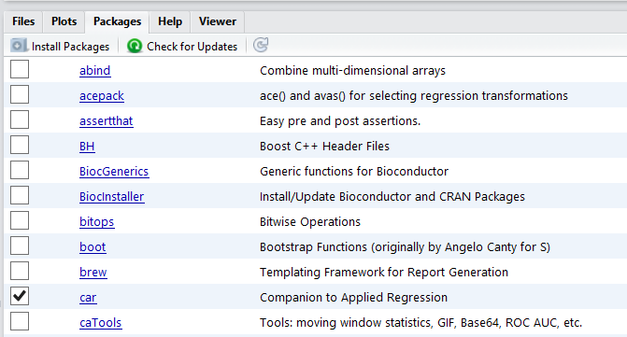
R basics: {packages}
Packages are collections of R functions, data, and compiled code in a well-defined format
Packages are stored in your local library
R comes with a standard set of packages
Other packages can be installed and loaded as needed
To load an installed package, use the function library() or check the appropriate box listed under ‘Packages’ in RStudio
Notes:
Show how to install packages
Show how to load packages: checking the box (car) or by using library(gridExtra). What are the benefits of each?
You will soon find out that if you need multiple packages loaded for your code to work, you don’t want to search your list and check each box every time you want to use your script. Instead, use library() and include it in your script so that they are automatically loaded! (We’ll go back to the ins and outs of this process a little later)

Slide 27
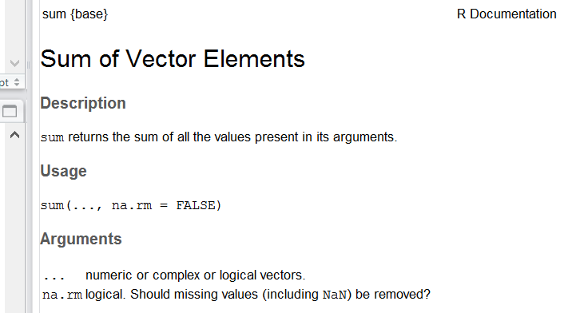
R basics: Help pages
You can access the function’s help file within RStudio
?sum() will search your loaded packages for sum()
??sum() will search through your installed packages for sum() and the keyword “sum”
Notes:
There are thousands of functions, and you won’t always remember what arguments a function is looking for, or how exactly it works. Although there is a vast R community online, you should start your query by looking at the R help page for the function. You can do this directly from Rstudio. Show them sum() and work out how it is done.
Note: multiple arguments, na.rm=FALSE means that the name of that argument is “na.rm” and the default value for the argument is “FALSE”. In the description, we see what the argument does and note that we’re going to be dealing with this specifically, later on.

Slide 28
Exercise 1.2
(A) Use R as a calculator
(B) Practice some simple functions
Try these out; remember that each function needs an argument!
log10()
abs()
(C) Install and load these non-standard packages:
{ggplot2} {lubridate}
{dplyr} {reshape2}
(D) Bring up a help page
mean()
Notes:
Timing: 3 minutes + until packages are loaded

Slide 29
R basics: objects
An object is a stored value or set of values (elements)
An object is a container that holds values and attributes (can be very complex)
Notes:
Quite often, we don’t want to type out a value or a set of values repeatedly. Instead, we want to be able to put these values into a container and give it a name that we can use to quickly call on later.

Slide 30
R basics: objects (scalars)
An object is a stored value or set of values (elements)
An object is a container that holds values and attributes (can be very complex)
> pi
[1] 3.141593
The simplest type of object is a scalar.
It is one dimensional with a length of one.
Notes:
Pi is a built in scalar

Slide 31
R basics: objects (scalars)
An object is a stored value or set of values (elements)
An object is a container that holds values and attributes (can be very complex)
> pi
[1] 3.141593
> myval<-5+10 # Create an object called myval, which contains the value of 5 + 10
> myval # Return the value of the object myval
[1] 15
The simplest type of object is a scalar.
It is one dimensional with a length of one.
Notes:
The <- assigns a value
Note that = does the same thing, but best practice is to use <- … we can get into it if you like, but I’m asking you to just trust me on that. It is for a couple very good reasons, but everyone will have their own opinion and coding habits.

Slide 32
R basics: objects (vectors)
An object is a stored value or set of values (elements)
An object is a container that holds values and attributes (can be very complex)
> letters
[1] “a” “b” “c” “d” ...
The most common type of object is a vector.
It is one dimensional with a length > one.
Notes:
Letters is a built-in vector

Slide 33
R basics: objects (vectors)
An object is a stored value or set of values (elements)
An object is a container that holds values and attributes (can be very complex)
> letters
[1] “a” “b” “c” “d” ...
> mycols<-c(“red”,“blue”,“yellow”,“green”)
> mycols
[1] “red” “blue” “yellow” “green”
The most common type of object is a vector.
It is one dimensional with a length > one.
Notes:
c() is a simple function that essentially combines or concatenates values

Slide 34
R basics: data classes
Vectors can only contain one class of data (“atomic”)
Variables can have various classes
num are numbers with decimals (e.g. 10.3)
int are integers (e.g. 10)
chr are character strings (e.g. “a”, “small”)
factor text or numbers stored as text, with unique levels
Hierarchical structure of data classes

Slide 35
R basics: data classes
Check and convert data classes
> mycols
[1] “red” “blue” “yellow” “green”
> class(mycols) # What class is mycols?
[1] “character”
> as.factor(mycols) # View it as a factor
[1] red blue yellow green
Levels: blue green red yellow

Slide 36
R basics: data classes
> mycounts<-c(1, 6, 13, 2, ‘about 5’, 2)
> mean(mycounts) # Average mycounts
[1] NA
Warning message: In mean.default(mycounts): argument is not numeric or logical: returning NA
> class(mycounts) # What class is mycounts?
[1] “character”
> as.numeric(mycounts)
[1] 1 6 13 2 NA 2
Warning message: NAs introduced by coercion

Slide 37
R basics: nas
NAs are automatically inserted into blank cells in your dataset upon importing
Cells that contain NA are also coerced to NA
> ncounts<-as.numeric(mycounts)
> mean(ncounts) # Average ncounts
[1] NA
# Most functions have an argument specifically used to ignore NAs
> max(ncounts, na.rm=TRUE) # Default na.rm=FALSE
[1] 4.8
Consider: “Should the value be a 0 or an NA?”

Slide 38
best practices: Objects
When naming objects:
Short, but easily recognizable
Avoid capitals, limit punctuation
Consistent format
Good: meanage, heights_2013 , heights_2014
Bad: a, a2, AverageCarapaceLengthOfCrabsIn2013
Good:
> object1<-5
Bad:
> “red”->object2
> object3=14

Slide 39
Exercise 1.3
Create a scalar called myname that contains your first name
Create a vector called mybirthday that contains three numeric elements; your day, month, and year of birth
Create a vector called test that contains both numeric and character elements. What does class() tell you about test?
Convert test to a factor and call it ftest. Now convert ftest to a numeric object called ntest. What do you notice about ntest?
Notes:
3 minutes

Slide 40
R basics: Indexing
Positional attributes designated by [ ]
Included in output
> 1:100
[1] 1 2 3 4 5 6 7
[8] 8 9 10 11 12
[13] 13 14 15 16 ...
Used to query objects
object[indexing]
Knowing how many dimensions the object has will tell you how many index values to include!

Slide 41
R basics: indexing
Our object mycols is a vector; one dimensional
# View mycols
> mycols
[1] “red” “blue” “yellow” ”green”
When indexing, we give it one positional value or one set of values
# View element in position 3 in mycols
> mycols[3]
[1] “yellow”

Slide 42
R basics: indexing
Our object mycols is a vector; one dimensional
# View mycols
> mycols
[1] “red” “blue” “yellow” ”green”
When indexing, we give it one positional value or one set of values
# View elements in positions 2 to 4 in mycols
> mycols[2:4]
[1] “blue” “yellow” “green”

Slide 43
R basics: indexing
Our object mycols is a vector; one dimensional
# View mycols
> mycols
[1] “red” “blue” “yellow” ”green”
When indexing, we give it one positional value or one set of values
# View elements in positions 1, 3 and 4 in mycols
> mycols[c(1,3,4)]
[1] “red” “yellow” “green”
> mycols[-2]
> “red” “yellow” “green”

Slide 44
R basics: conditional indexing
What if we don’t know the positional values of the elements we want to look at? We use conditional or logical statements!
# Are elements of mycols equal to “blue”?
> mycols==“blue”
[1] FALSE TRUE FALSE FALSE
A==5 asks “does A equal 5?”
A=5 sets the value of A to 5

Slide 45
R basics: conditional indexing
What if we don’t know the positional values of the elements we want to look at? We use conditional or logical statements!
# Are elements of mycols equal to “blue”?
> mycols==“blue”
[1] FALSE TRUE FALSE FALSE
We need to find a numeric value to use for indexing.
# Which elements of mycols equal to “blue”?
> which(mycols==“blue”)
[1] 2
Now there are two options; hard coding versus soft coding.

Slide 46
R basics: conditional indexing
Hard Coding
# Show me elements of mycols equal to “blue”
> which(mycols==“blue”)
[1] 2
> mycols[2]
[1] “blue”
Soft Coding
# Show me elements of mycols equal to “blue”
> mycols[which(mycols==“blue”)]
[1] “blue”
> mycols[mycols==“blue”]
[1] “blue”

Slide 47
R basics: conditional indexing
# View elements in mycols that are either “blue” or
“green”
> mycols[mycols %in% c(“blue”,”green”)]
[1] “blue” “green”
# View elements in mycols that are not equal to “red”
> mycols[!mycols==“red”]
[1] “blue” “yellow” “green”

Slide 48
R basics: conditional indexing
# Create a vector called one_ten containing all integers from 1 to 10
> one_ten<-1:10
# View elements greater than or equal to 8
> one_ten[one_ten>=8]
[1] 8 9 10
# View elements less than 5 and greater than 2
> one_ten[one_ten<5 & one_ten>2]
> [1] 3 4
# View elements less than 3 or greater than 9
> one_ten[one_ten<3 | one_ten>9]
> [1] 1 2 10

Slide 49
Exercise 1.4
(A) Create an object called numvals consisting of a vector of numeric elements generated from a function; try using either seq() or rnorm()
(B) Take a good look at your object
Try out these functions:
length() max() sort()
unique() min() quantile()
(C) Find all values of numvals greater than the average
(D) Find all values of numvals that are in the top 10%. Store these values in an object called topvals
(Hint: quantile() .. change a default argument!)
End Maine_CodeAlong1.R
Notes:
5 minutes

Slide 50
Coffee break!

Slide 51
best practices: R SCRIPT
Always #comment your code! Always. Seriously… ALWAYS.
R doesn’t try to read or interpret #comments; use them to keep track of what you are doing and why.
Your code should have well defined sections, such as:
Description
Set Working Directory
Load Packages
Import Data
To create collapsible sections and a drop-down menu in RStudio, use:
# ---- Section Title Here ----
You need to be aware of what objects exist in the Environment, and remember that order matters!

Slide 52
Working directory
The working directory is the location (folder) that R is going to communicate with when importing files, exporting figures, etc.
Option A: Create a Project
File > New Project > Existing Directory > MaineR
Pro: Saves you from needing to explicitly specify; relational
Con: Need to open script using the project shortcut
Option B: Manually Set a Working Directory
setwd(“C:/Users/Danielle/Desktop/MaineR”)
Pro: Can open RStudio directly and have multiple scripts ongoing
Con: Need to update if files are moved or folders renamed

Slide 53
best practices: DATA
Avoid dealing with frustrating issues later by following some simple rules now:
Single flat file (at least to start…)
Save as a .txt or .csv
Every column uniquely and simply named
Individual column for each component of date/time
(We’ll cover this in more detail later.)
everything lowercase with no punctuation
Create a variable key
No data? Leave it blank or use NA … but be consistent!

Slide 54
Getting started
Make sure that your course materials are saved in an appropriate location (i.e. NOT your Downloads folder!)
Save your dataset as a .txt in the same folder as above (Remember that some features, such as formulas, may be lost when converted)
Open a new .R script, create a section called “Set Working Directory”, and set your working directory to the appropriate folder
setwd(“C:/Users/Danielle/Desktop/MaineR”)
Import your data! In a perfect world…
mydata<-read.delim(“filename.txt”)
View(mydata) # View data in new tab
Start Maine_CodeAlong2.R or your own script
Notes:
To Do: Create mydata.txt that has the common data issues described in the following slides (NOT the importing issues)

Slide 55
Problems importing data
Error Message: Error in file(file, “rt”) : cannot open the connection In addition: Warning message: In file(file, “rt”): cannot open file ‘sample’: No such file or directory
Issue: R can’t find your file in the working directory you specified
Check: Did you set your working directory correctly?
Did you spell the filename correctly?
Did you include “.txt” in your filename?
Did you save your file as a .txt in the correct folder?
Troubleshooting: Use list.files() to see a list of all the files available in your current working directory.

Slide 56
Problems importing data
Error Message: None
Issue: The dataset just doesn’t look right!
Check: Is your spreadsheet set up right?
no merged cells
no extra rows (i.e. first row are variable names, data begins on second row) or blank rows
no spaces or punctuation in variable names (may or may not cause issues, depending on specific circumstances)
Excel can be finicky, and “activate” empty cells in extra rows and/or columns. Do you see columns “X.1”, “X.2”?
if you don’t have headers (column names) in your dataset, you need to change the header argument from TRUE (default) to FALSE
mydata<-read.delim(“filename.txt”, header=FALSE)

Slide 57
Data frames: basics
To look at a data frame:
View() spreadsheet of data frame in new tab
str() structure of each variable
summary() summary of each variable
dim() dimensions (rows, columns)
head() output the first six rows
Columns have unique names – these are variable names
names() gives you variable (column) names
Notes:
MOVE MODES TO R BASICS

Slide 58
Exercise 1.5
Ensure you have:
a new .R script
your working directory set under a “Set Working Directory” section
your .txt data file imported into R
Confirm that your data was imported correctly
Correct number and names of variables (columns)?
Correct number of observations (rows)?
Check for obvious data entry errors
Does the data mode of each variable make sense?
Do the summary statistics of each variable make sense?
View(mydata) str(mydata) summary(mydata)
dim(mydata) head(mydata) names(mydata)
Notes:
whitespaces (e.g. 5 versus 5_ will be read as two different values)
upper and lower case characters are read differently

Slide 59
Common data issues
Problem: My numeric values aren’t numeric
Explanation: Somewhere in the column (vector), there is a value that is being recognized as a character; likely due to a space following a number, or a non numeric entry (i.e. “approx. 4”)
Solutions:
Find and remove white spaces:
data$values<-as.numeric(gsub(“ ”, “”,data$values))
Check for non-numeric entries:
unique(data$values)

Slide 60
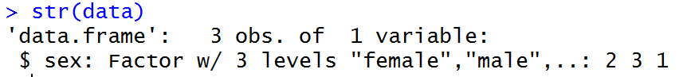
Common data issues
Problem: My factor levels are incorrect; there should be 2 levels
Explanation: Most likely, either an entry is followed by a space (“male” vs “male ”), capitalization is inconsistent (“male” vs “Male”), or you have blank values (NAs), which act as a third level.
Solutions:
Find and remove white spaces:
data$sex<-as.numeric(gsub(“ ”, “”,data$sex))
Convert everything to lowercase:
data$sex<-tolower(data$sex)

Slide 61
Data frames: structure
Concept 1: Each column of a data frame is a vector
Concept 2: Data frames are two dimensional (row, column)

Slide 62
1. each column is a vector
Each column is labelled as a variable and is denoted by $
mydata$length outputs the contents of the column called length in the data frame object mydata as a vector
Indexing works the same way as any other vector; to see the 5th element of the vector mydata$length, use mydata$length[5]

Slide 63
1. each column is a vector
Each column is labelled as a variable and is denoted by $
mydata$length outputs the contents of the column called length in the data frame object mydata as a vector
Indexing works the same way as any other vector; to see the 5th element of the vector mydata$length, use mydata$length[5]
Vector, 1D
One value

Slide 64
1. each column is a vector
Each column is labelled as a variable and is denoted by $
mydata$length outputs the contents of the column called length in the data frame object mydata as a vector
Indexing works the same way as any other vector; to see the 5th element of the vector mydata$length, use mydata$length[5]
# Output a subset of the mydata$length vector where length > 10
mydata$length[mydata$length>10]

Slide 65
2. Two dimensional
Need to give it two values when indexing; indicate both the rows and columns of interest
R uses [row,col] assignment
mydata[1,2] outputs the value of row 1, column 2

Slide 66
2. Two dimensional
Need to give it two values when indexing; indicate both the rows and columns of interest
R uses [row,col] assignment
mydata[1,2] outputs the value of row 1, column 2
Data frame, 2D
Two values

Slide 67
2. Two dimensional
Need to give it two values when indexing; indicate both the rows and columns of interest
R uses [row,col] assignment
mydata[1,2] outputs the value of row 1, column 2
mydata[1:5,c(1:3,6)] outputs rows 1 to 5 and columns 1, 2, 3, and 6
You can leave one value blank to select all
mydata[,3] outputs all rows and column 3
mydata[1:5,] outputs rows 1 to 5 and all columns

Slide 68
2. Two dimensional
Need to give it two values when indexing; indicate both the rows and columns of interest
# Output a subset of the mydata data frame where length > 10
mydata[mydata$length>10]
# Why does this give you an error?

Slide 69
Data frames: modifying variables
What if I want to add a new variable (i.e. create a new column)?
mydata$ratio<-mydata$length/mydata$weight
What if I want to change an existing variable?
# Rather than eggs representing the number of eggs, we want it to represent presence (1) and absence (0) of eggs
mydata$eggs[mydata$eggs>0]<-1
# Females with no eggs should be 0, but males should all be NA
mydata$eggs[mydata$sex==“m”]<-NA
Note: The package {car} has a function called recode() extremely useful in complex variable recoding!

Slide 70
Exercise 1.6
Using what we’ve learned about indexing:
Create a subset of mydata that contains only males captured in 2013
Find the average length of females in mydata
End Maine_CodeAlong2.R
Notes:
whitespaces (e.g. 5 versus 5_ will be read as two different values)
upper and lower case characters are read differently

Slide 71

Module 2: Exploring & visualizing data
Formatting Dates
Using {lubridate} to format dates (Praise Hadley I)
Summarizing Data
Using {dplyr} to summarize data (Praise Hadley II)
Visualizing Data
Using {ggplot2} to visualize data (Praise Hadley III)
Using {reshape2} to restructure data (Praise Hadley IV)

Slide 72
Dates
Dates are a constant P.i.t.A. in R – I blame Excel.
Essentially, dates need to be reformatted within R to avoid being interpreted as nonsense factors, characters or integers and instead be interpreted as POSIX
Numerous approaches; I prefer using dmy() and/or dmy_hm() from the lubridate package
www.daniellequinn.github.io/RLessons/FormattingDates

Slide 73
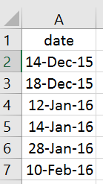
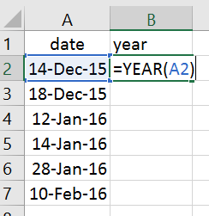
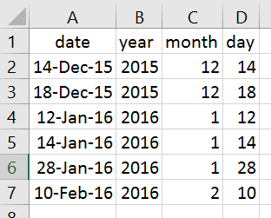
best practices: DATes
Separate columns for each date and time component
Store as numeric values

Slide 74
DatEs: lubridate::dmy()
The function dmy() is fairly flexible in terms of what kind of argument it requires
But, it’s always wise to be consistent; use an argument that is a character string in the following format: “dd-mm-yyyy”
Step 1: Ensure that you have a single column for each date/time component (or use the provided dataset date_data.txt)
exdata<-read.delim(date_data.txt)
Step 2: Use the paste() function to create a vector of class character
dvec<-paste(exdata$day, exdata$month, exdata$year, sep=“-”)
Step 3: Wrap this vector with dmy() and use it to create a new column
exdata$date<-dmy(dvec)
Start Maine_CodeAlong3.R

Slide 75
Exercise 2.1
(A) Use dmy_hms() to create a column in exdata called datetime that contains both date and time information.
(B) Go to your own .R script and format dates and/or datetimes using your own data
Note: If R experiences an error, it will stop running the piece of code, and report the error to you. If you receive a warning, it means that the code ran successfully, but you need to check the warning using warning() to be sure it ran correctly.
When using dmy() or dmy_hm() you may see a warning “___failed to parse”. This means that somewhere in your dataset a portion of your date (day, month, etc.) was missing and the overall date becomes NA.
Notes:
20 slides + 3 exercises

Slide 76
Lunch!

Slide 77
Summary Stats: methods
Data analysis often begins with generating summary statistics
There are many simple ways to summarize your data!
# Counts
table(mydata$year)
table(mydata$year, mydata$sex)
# Statistics
library(doBy)
summaryBy(weight~year+sex, data=mydata)
summaryBy(weight~year+sex, data=mydata, FUN=min)
Each method has pros and cons, and your use will change depending on the situation
However…
Notes:
base : : table( )
doBy : : summaryBy( )
dplyr : : summarize( )

Slide 78
Summary stats: {dplyr}
{dplyr} is a package developed by Hadley Wickham for summarizing data in a flexible and customizable way without worrying about indexing or looping
filter() simplified conditional indexing
select() simplified conditional indexing
group_by() stratify by a variable
summarise() apply flexible summary statistics
%>% “pipe”; pass results on left to functions on right

Slide 79
Summary stats: {dplyr}
# Subset mydata to look only at males
# Option 1 (indexing)
mydata[mydata$sex==“m”,]
# Option 2 (dplyr)
mydata%>%
filter(sex==“m”)

Slide 80
Summary stats: {dplyr}
# Subset mydata to only year and length columns
# Option 1 (indexing)
mydata[,c(“year”, ”length”)]
# Option 2 (dplyr)
mydata%>%
select(year, length)

Slide 81
Summary stats: {dplyr}
# Find the mean length, by year
# Option 1 (indexing/looping)
year<-unique(mydata$year)
mlength<-c()
for(i in year)
{
mlength.in<-mean(mydata$length[mydata$year==i], na.rm=TRUE)
mlength<-c(mlength, mlength.in)
}
table1<-data.frame(year, mlength)
# Option 2 (dplyr)
table1<-mydata %>%
group_by(year) %>%
summarise(mlength=mean(length, na.rm=TRUE)) %>%
data.frame()

Slide 82
Exercise 2.2
(A) Use {dplyr} to generate a summary table of the mean weights of individuals with a length greater than 10, by both sex and year, along with the standard deviation around those means
year<-unique(mydata$year)
sex<-c()
mweight<-c()
sdweight<-c()
for(i in year)
{
for(ii in unique(mydata))
{
sex.in<-as.character(ii)
sex<-c(sex, sex.in)
x<-mydata$weight[mydata$length>10 &
!is.na(mydata$length) &
mydata$year==i &
mydata$sex==ii]
mweight.in<-mean(x, na.rm=TRUE)
mweight<-c(mweight, mweight.in)
sdweight.in<-sd(x, na.rm=TRUE)
sdweight<-c(sdweight, sdweight.in)
}
}
table2<-data.frame(year, sex, mweight, sdweight)
Notes:
20 slides + 3 exercises

Slide 83
Summary stats: overview
Indexing / looping, table(), summaryBy(), and {dplyr} all have strengths and weaknesses.
You’ll likely end up using all of them at some point, depending on the circumstances.
 | Simple | Flexible | Efficient
Indexing/Looping | x | ☺☺☺ | xx
table() | ☺☺☺ | x | ☺☺
summaryBy() | ☺ | ☺ | ☺
{dplyr} | ☺☺ | ☺☺ | ☺☺☺

Slide 84
Visualizations in R
R has the capabilities to produce some beautiful and informative graphics!

Slide 85
Visualizations in R
R has the capabilities to produce some beautiful and informative graphics!
“So does Excel!”

Slide 86
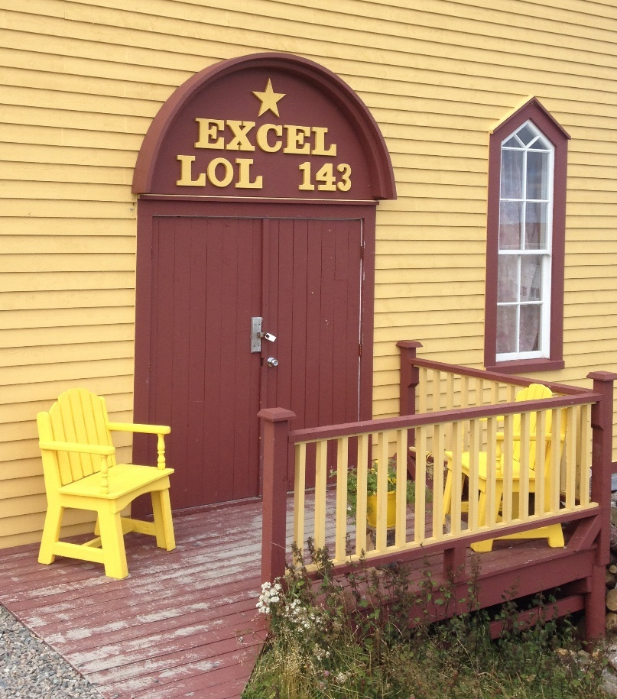
Visualizations in R
R has the capabilities to produce some beautiful and informative graphics!

Slide 87
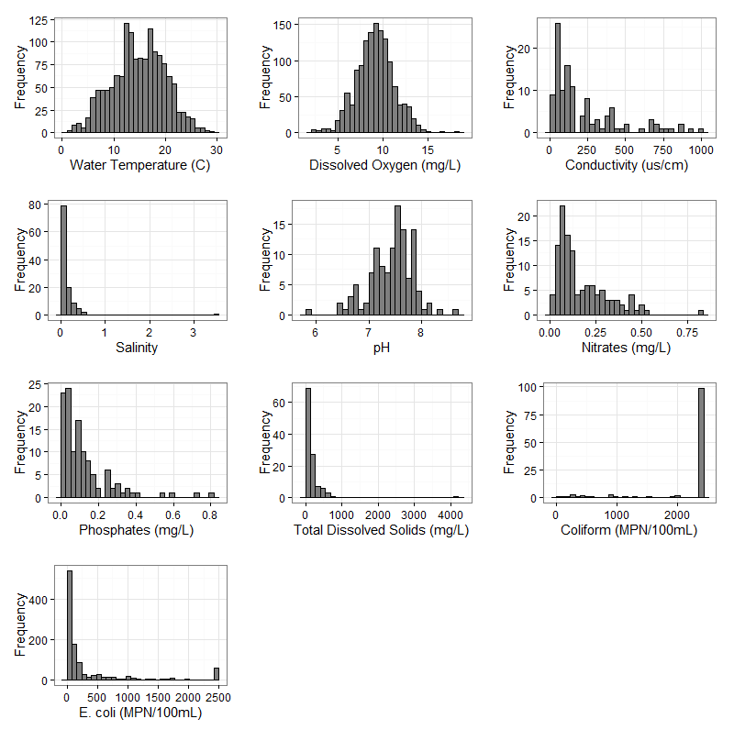
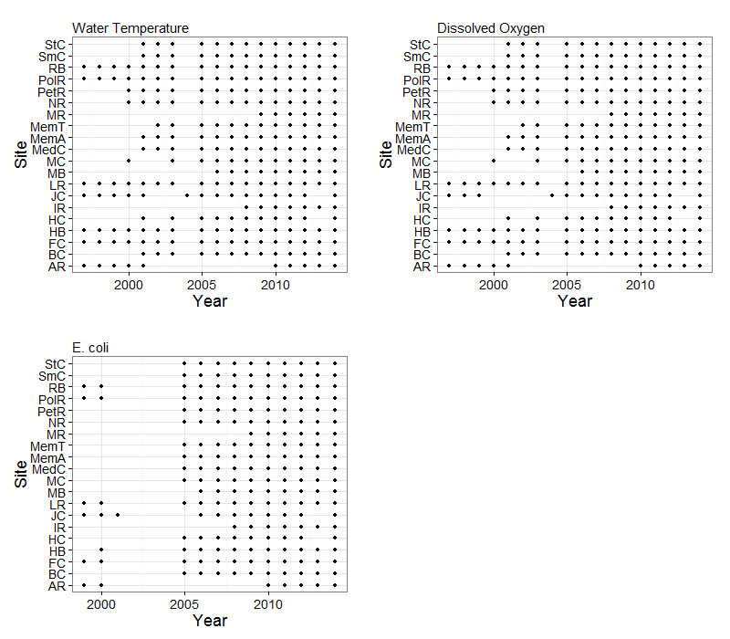
Data exploration and diagnostics using simple visualizations
Identifying data gaps and visualizing multi-dimensional sampling effort

Slide 88
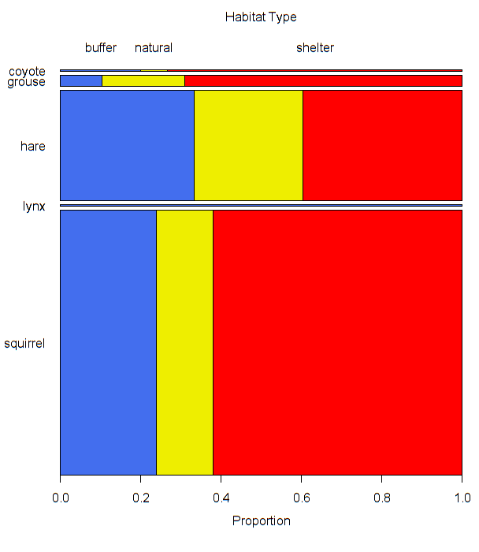
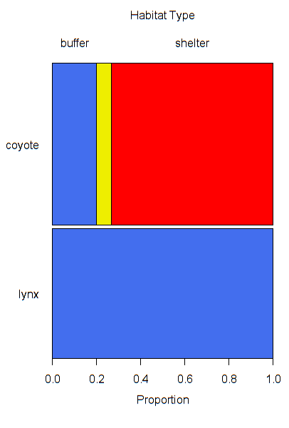
Proportional activity levels of mammal species across Cape Breton habitats

Slide 89
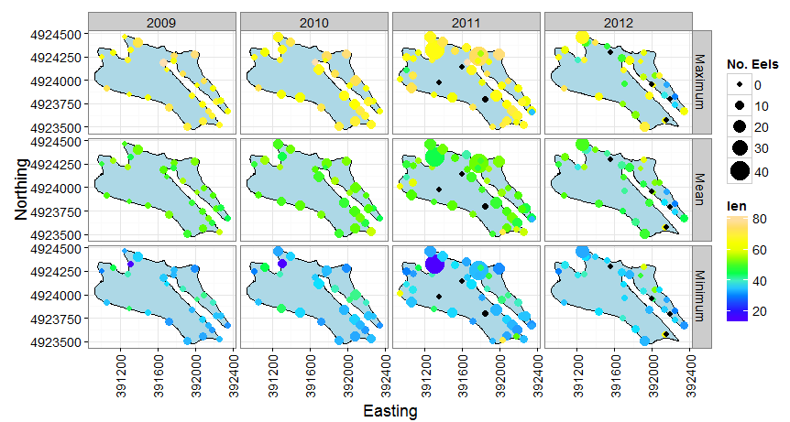
Distribution and size of American eels across habitat gradients in Oakland Lake, Nova Scotia

Slide 90
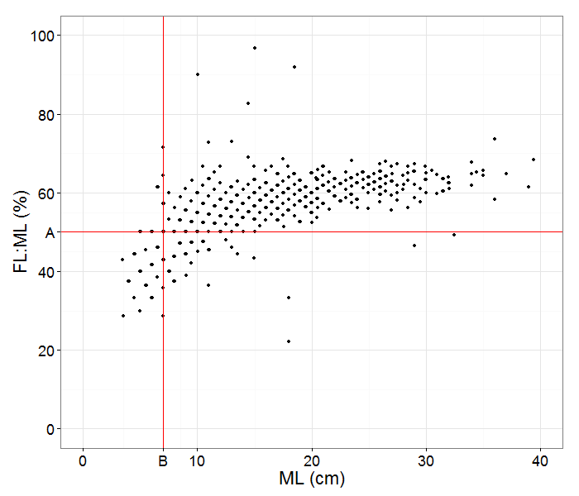
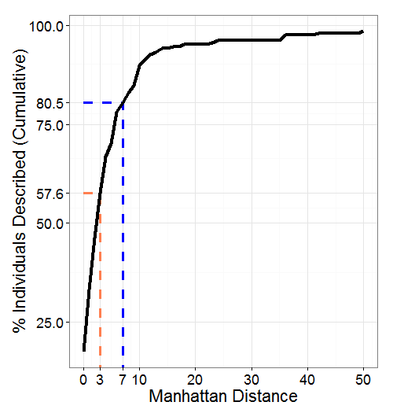
Using morphological ratios in species identification of squid
Quantifying social cohesion in skate species in the Bay of Fundy

Slide 91
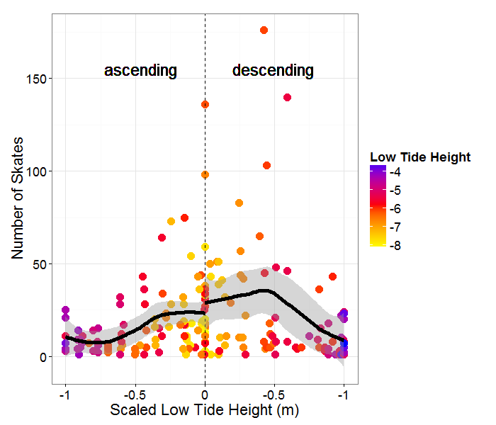
Winter and Little Skate abundance across tidal cycles, lunar phases, and water depth

Slide 92
Optimizing efficiency of dung beetle trapping protocols in South Africa

Slide 93
Visualizations in R: base plot
R comes with built in functions (found in your standard library packages) for producing figures (“base plots”)
First plots made using these functions
Pros: Robust and fairly simple
Cons: Methods to add or change aesthetics and complexity aren’t standardized and don’t feel intuitive; lots of extra typing needed and you’ll still rarely achieve clean, high quality plots

Slide 94
Visualizations in R: {ggplot2}
Runs off the basic concept of adding layers to an otherwise blank plot
Pros: Methods to add or change aesthetics and complexity are fairly standardized (clear patterns in the code!) and feel like they ‘make sense’, and ggplots can be contained in objects
Cons: For beginners, the code can initially look intimidating; specific limits in customizing plots (Wickham says “single Y axis only!”)

Slide 95
When do I use base plot?
Quickly checking your dataset for quality or summary information
Diagnostic plots (modelling)
# plot(): scatterplot, 2 numeric vectors
plot(x=mydata$length, y=mydata$weight)
# plot(): boxplot, 1 numeric vector, 1 factor vector
plot(x=mydata$sex, y=mydata$length)
# boxplot(): boxplot, 1 numeric vector, 1 factor vector
boxplot(mydata$length~mydata$sex)
# hist(): histogram, 1 numeric vector
hist(mydata$length)
Notes:
Scatterplot, histogram, boxplot – 3 that are used most often and quickly
Some objects have inherent plots associated with them (i.e. models)

Slide 96
When do I use ggplot?
Every other time… when you want complex and/or high quality figures!
Adding layers to a blank slate
ggplot(mydata, aes(x=length, y=mass))+
geom_point()
Notes:
Explain concept of layers

Slide 97
When do I use ggplot?
Every other time… when you want complex and/or high quality figures!
Adding layers to a blank slate
ggplot(mydata, aes(x=length, y=mass))+
geom_point()
Sets up the plotting space
Notes:
Get them started with an example

Slide 98
When do I use ggplot?
Every other time… when you want complex and/or high quality figures!
Adding layers to a blank slate
ggplot(mydata, aes(x=length, y=mass))+
geom_point()
Sets up the plotting space
Specifies that mydata will be used
Notes:
Get them started with an example

Slide 99
When do I use ggplot?
Every other time… when you want complex and/or high quality figures!
Adding layers to a blank slate
ggplot(mydata, aes(x=length, y=mass))+
geom_point()
Sets up the plotting space
Specifies that mydata will be used
Want length on x axis, mass on y
Notes:
Get them started with an example

Slide 100
When do I use ggplot?
Every other time… when you want complex and/or high quality figures!
Adding layers to a blank slate
ggplot(mydata, aes(x=length, y=mass))+
geom_point()
Sets up the plotting space
Specifies that mydata will be used
Want length on x axis, mass on y
aes stands for “aesthetics” – how do we want our dataset to be shown?
Notes:
Get them started with an example

Slide 101
When do I use ggplot?
Every other time… when you want complex and/or high quality figures!
Adding layers to a blank slate
ggplot(mydata, aes(x=length, y=mass))+
geom_point()
Sets up the plotting space
Specifies that mydata will be used
Want length on x axis, mass on y
aes stands for “aesthetics” – how do we want our dataset to be shown?
Specifies that we want to make a scatterplot
Notes:
Get them started with an example

Slide 102
Visualizations in R: {ggplot2}
Various ways to accomplish the same thing
ggplot(mydata, aes(x=length, y=mass)+
geom_point()
Notes:
Get them started with an example

Slide 103
Visualizations in R: {ggplot2}
Various ways to accomplish the same thing
ggplot(mydata, aes(x=length, y=mass)+
geom_point()
ggplot(mydata)+
geom_point(aes(x=length, y=mass))
Notes:
Get them started with an example

Slide 104
Visualizations in R: {ggplot2}
Various ways to accomplish the same thing
ggplot(mydata, aes(x=length, y=mass)+
geom_point()
ggplot(mydata)+
geom_point(aes(x=length, y=mass))
ggplot()+
geom_point(aes(x=length, y=mass), data=mydata)
Notes:
Get them started with an example

Slide 105
Visualizations in R: {ggplot2}
# Add colour using the argument col = ‘red’
# If col is outside of the aes() function…
ggplot(mydata) +
geom_point(aes(x=length, y=weight), col=‘red’)
# If col is inside the aes() function, it can be
# linked to the dataset
ggplot(mydata) +
geom_point(aes(x=length, y=weight, col=sex))

Slide 106
Visualizations in R: {ggplot2}
There are a huge number of ways to tweak these plots - it’s up to you to explore these using your own data!
For some basic tips and tricks, look at the online guide called R Cookbook.
Some of my personal favorite tricks are:
theme_bw() # Black and white theme
scale_colour_manual() # Specify colours to use
facet_grid() # Create grid of plots based on specific factors
Notes:
Reference R Cookbook

Slide 107
Exercise 2.3
Use {dplyr} and {ggplot2} to generate summary tables and plots of your own data!
End Maine_CodeAlong3.R

Slide 108
Module 3: Linear models to gLMs
Linear models
Setting up a model
Interpreting the output
It looks good to me…
Model diagnostics
Random patterns?
Dispersion
Changing the distribution with GLMs
Setting up a model
Interpreting the output
Model diagnositcs
All models are bad, but some are informative
Model selection
Notes:
32 slides (24 unique) + 4 exercises

Slide 109
Exercise 3.1
Open Maine_CodeAlong4.R
Ensure that the working directory is set properly
Load the package {ggplot2}
Install and load the package {MASS}
Source in HighStatLib.R and MoreFunctions.R
Import Baileyetal2008_modified.txt as a data frame object called fish
Ensure that the data were imported correctly
Create a new column called depth_km containing depth_m converted to km
Start Maine_CodeAlong4.R
Notes:
whitespaces (e.g. 5 versus 5_ will be read as two different values)
upper and lower case characters are read differently

